Slide 1

FORGERY IMAGE DETECTION SYSTEM TEAM MEMBERS ABRAHAM JUSTIN 23MIA1027 VENKATARAMAN R 23MIA1025 SUDARSHAN MANIKANDAN 23MIA1078

Slide 2
PROBLEM STATEMENT & MOTIVATION
Why Forgery Detection?
Image tampering is common in social media, journalism, legal evidence
Copy-Move forgery is hard to detect because copied regions look identical
Need systems that detect AND localize manipulation
Pure deep learning misses fine-grain copied regions
Traditional SIFT struggles in smooth texture areas

Slide 3
BASE PAPER SUMMARY
Base Paper : “An Effective Image Copy-Move Forgery Detection Using Entropy Information” (IEEE, 2024)
Uses entropy images to enhance keypoint extraction
Improves SIFT’s performance in smooth regions
Uses clustering for efficient matching
Inspired the SIFT enhancement stage in my system

Slide 4

METHODOLOGY FLOW DIAGRAM

Slide 5
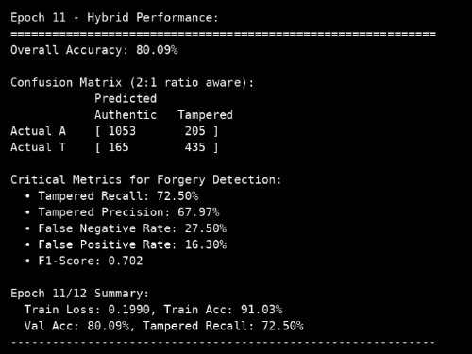
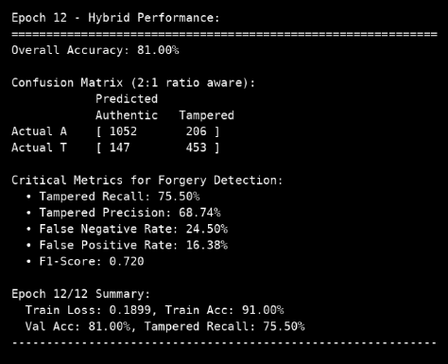
RESULTS - CLASSIFICATION METRICS

Slide 6
KEY FINDINGS
Hybrid method performs better than CNN-only or SIFT-only
Grad-CAM adds interpretability
Entropy-based SIFT improves keypoint density
Copy-move clustering accurately finds duplicated regions

Slide 7
FUTURE ENHANCEMENTS
Integrate Vision Transformers
Add JPEG/artifact analysis
Build real-time video forgery detection
Faster keypoint matching using ANN

Slide 8

Thank you

